Slide 1
Capstone Project
RETAIL SALES PREDICTION
SHREYAS HINGMIRE

Slide 2
INDEX
Problem Statement
Data Summary
Handling Missing Values
Modifying Columns
Exploratory Data Analysis
Predicting sales using Machine Learning Models
Comparing different models
Applying Decision Tree
Conclusion

Slide 3
PROBLEM STATEMENT
Rossmann operates over 3,000 drug stores in 7 European countries.
over 3,000 drug stores in 7 European countries.
Rossmann store managers were tasked to predict their daily sales for up to six weeks in advance.
With thousands of individual managers predicting sales based on their unique circumstances, the accuracy of results can be quite varied.
To solve this issue our task was to forecast the sales of the stores using regression model.

Slide 4
DATA SUMMARY
There were 2 datasets:
Rossmann stores data.csv
It contains historical data of sales of all stores of each day
Store.csv
It contains supplemental information of each store.

Slide 5
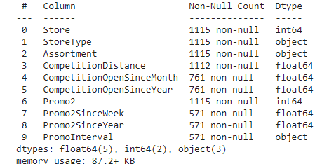
HANDLING MISSING VALUES
Rossmann stores data.csv
It contained no null values.
Store.csv
Few columns had null values

Slide 6
HANDLING MISSING VALUES
Whenever Promo2 was 0 the next 3 columns will not have any values; hence they were Nan . Those Nan values were replaced as 0.
For columns CompetitionDistance, CompetitionOpenSinceMonth and CompetitionOpenSinceYear mean values were taken and replaced with null values.

Slide 7
MODIFYING COLUMNS
The ‘Date’ column was of dtype - dateframe.
It was converted into 3 separate columns names date, month and year of
int dtype.
‘State Holiday’ column had 3 state holiday category -a,b,c.
All these 3 categories were converted into one renamed as 1.
Then both the datasets were merged on store column

Slide 8
EXPLORATORY DATA ANALYSIS

Slide 9
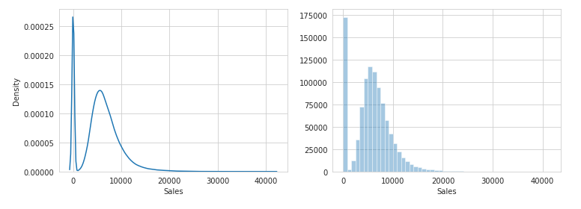
Distribution of Sales of all Stores

Slide 10
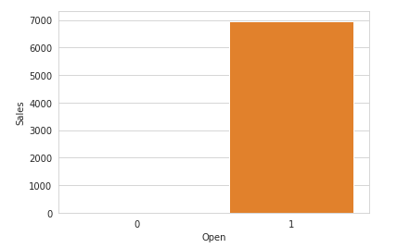
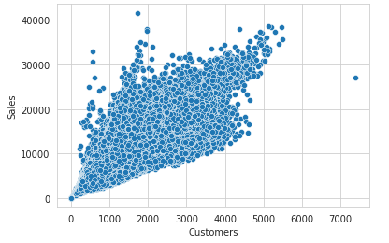

Slide 11
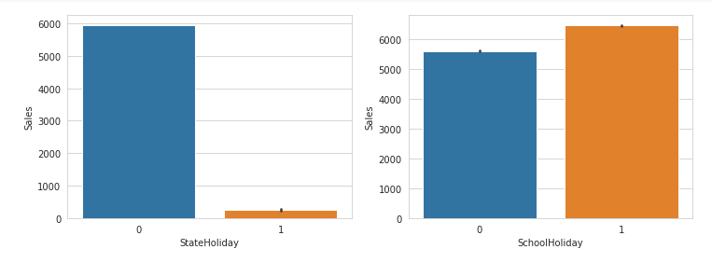
Impact of Holidays

Slide 12
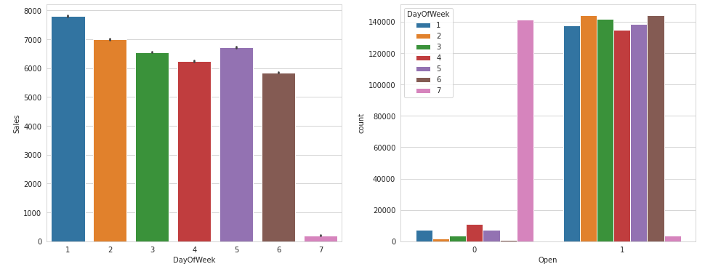
Impact of Day of week

Slide 13
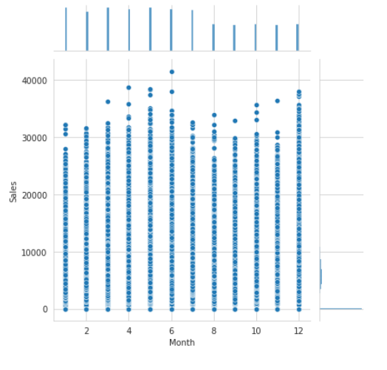
Analysis based on Month

Slide 14
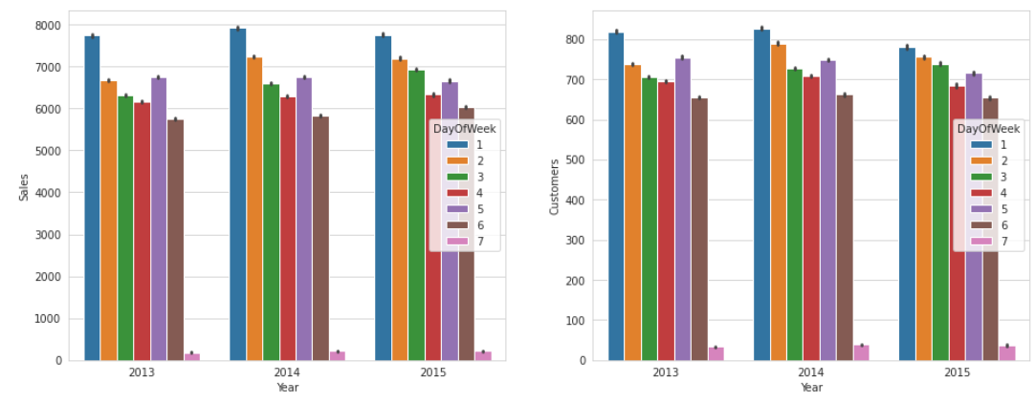
Analysis based on Year

Slide 15
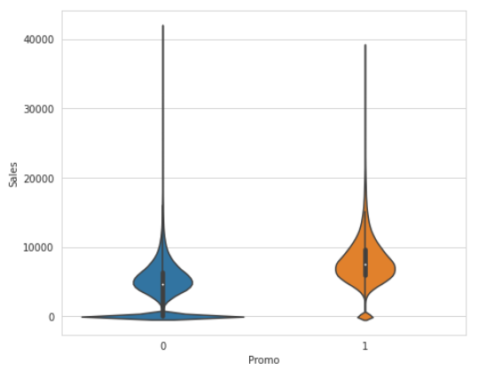
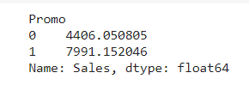
Effect of Promo on Sales

Slide 16
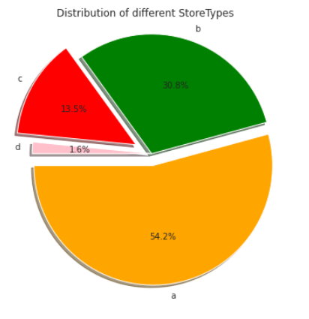
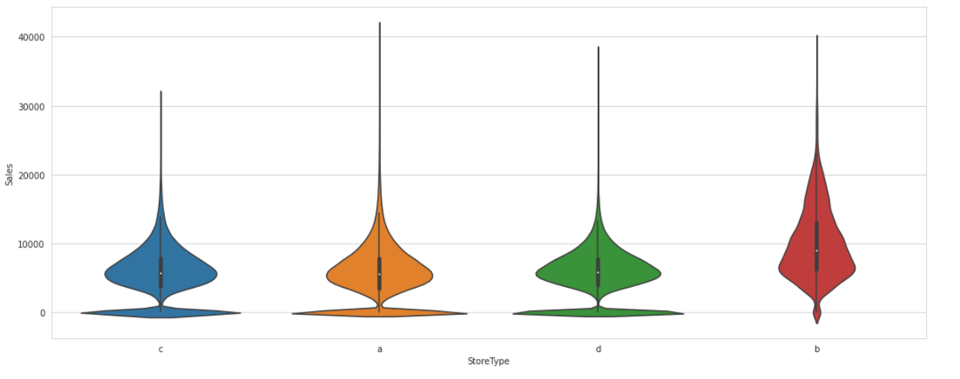
Effect of Store type on Sales

Slide 17
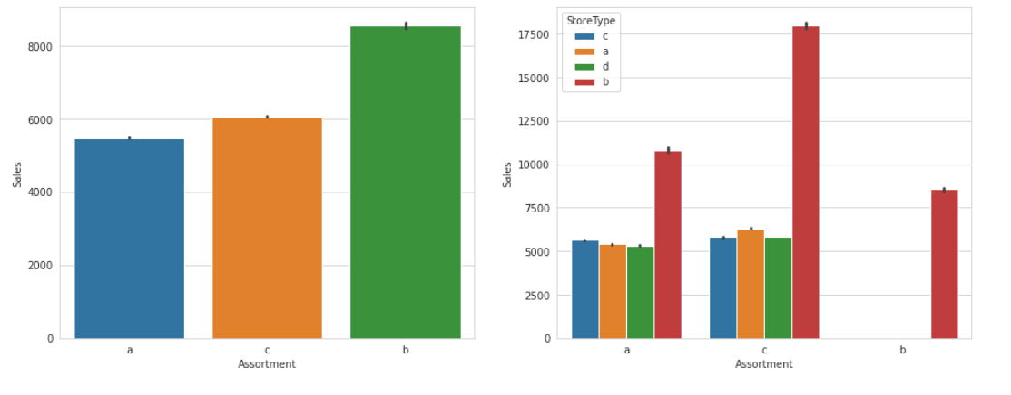
Effect of Assortment type on Sales

Slide 18
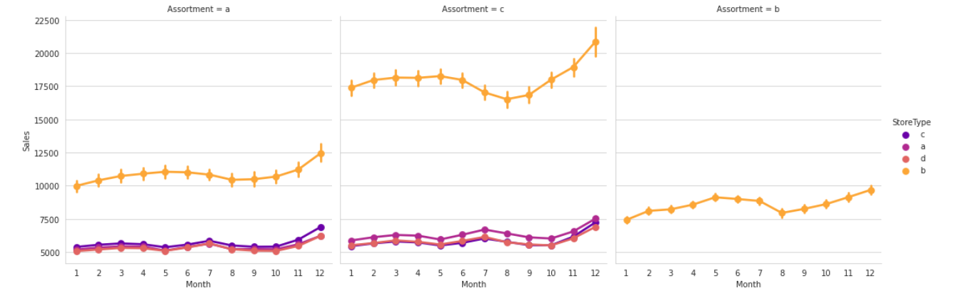

Slide 19
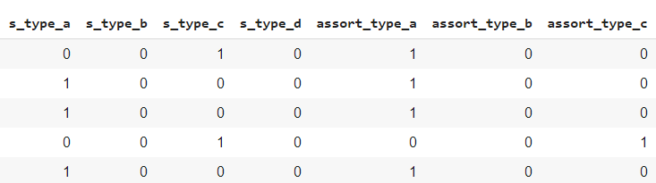
Feature Engineering
After applying VIF , customers column was selected and rest all were discarded.
One hot encoding was applied on categorical columns like Storetype, assortment and PromoInterval.

Slide 20
APPLYING MACHINE LEARNING MODEL TO PREDICT SALES

Slide 21
Comparing Accuracy of different Algorithms
Algorithm | Training Score | Test Score | Training RMSE | Test RMSE
Linear Reg | 89.8% | 89.83% | 1230 | 1226
Lasso Regularization | 89.8% | 89.83% | 1230 | 1226
Decision Tree | 93.69% | 92.21% | 968 | 1072
Random Forest | 96.97% | 90.98% | 670 | 1154

Slide 22
Applying Decision Tree
Decision Tree gives the best test score and minimum test rmse.
Hence hyperparameter tuning and cross validation was applied on decision tree model.
After applying , accuracy was increased from 92.22 to 92.46 ; and rmse was decreased from 1072 to 1055.
Other parameters:
Mean Absolute error : 704
Mean Squared error : 1113424

Slide 23
CONCLUSION
Decision Tree model gave the best accuracy of 92.26%.
The important features were customers, promo , dayofweek , storetype and open.

Slide 24
THANKYOU

